Slide 1
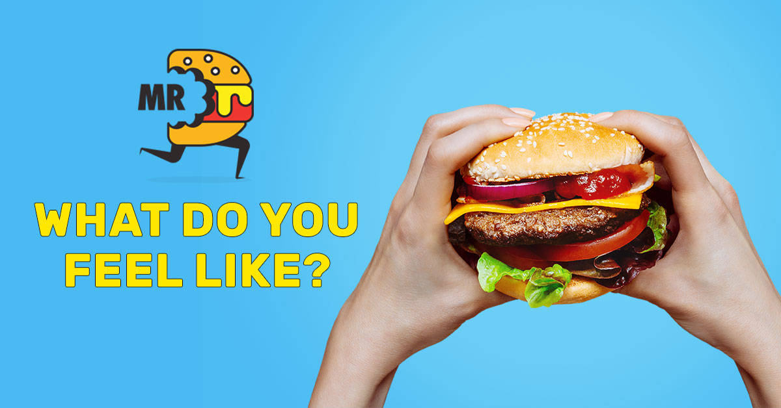
Mr Delivery
PROJECT PROPOSAL
MR DELIVERY
DONE BY:
Glen Hlongwane

Slide 2
Overview
Mr Delivery is an application, it simply refers to an on-line takeout order processer as opposed to the old traditional way of physically going to the restaurant to make an order as is strives to eliminate misunderstanding or wrong orders, saving time and money as they are both precious and valuable, making takeout delivery quick at a customer’s “doorstep” from anywhere within area range of available restaurants and obviously distressing people of what meal they are going to prepare as it might take time to prepare and worse if it was a tiring one.
In general Mr. Delivery may influence more people as the people can directly order food from the application itself without going anywhere. This makes people more convenient and flexible as they can have food at their home or office itself with their friends or family members.

Slide 3
Overview cont`d
Unlike the physical restaurant, Mr. Delivery will be serving in the entire city as it will maintain some relationships with the local restaurants.
So whenever a customer places an order, they deliver the food from the nearby restaurant to the customer as per the availability.
This makes them to serve faster and throughout the city even, which increases the target area. On the other hand a normal physical restaurant serves within a particular area which makes the target area comparatively less.
Even though, if normal restaurants go online and have their own website, they might not be able to serve in the entire city until and unless they maintain branches throughout the city.

Slide 4
Overview cont`d
Quick facts about online food ordering:
Attracting new customers - It gives new customers a quick and easy way to find and try your restaurant’s offerings. New customers are much more likely to try your food if the ordering process is quick, easy and painless.
Improving Customer Convenience - Restaurant meal ordering applications is one of the latest trends in food industry making customers to enjoy their food according to their convenience.
Effectual Online Promotion - One of the important feature is that it allows the food serving company to promote their restaurant and enables customer attraction
Increase in Sales- An online ordering system opens a window of opportunity for customers. Restaurants can customize their menus to highlight the menu specials or have them designed in a way they can make suggestions to the customer as they are ordering.

Slide 5
Contents
Introduction
Overall Description
Analysis & Design

Slide 6
Introduction
It is known globally that, in today’s market, it is extremely difficult to start a new small-scale business and live-through the competition from the well-established and settled owners. Nowadays when everyone is squeezed for time, the majority of people are choosy when it comes to placing a food order.
The customers of today are not only attracted because placing an order online is very convenient but also because they have visibility into the items offered, price and extremely simplified navigation for the order. Mr. Delivery, the application that I am proposing here, greatly simplifies the ordering process for both the customer and the restaurant.
System presents an interactive and up-to-date menu with all available options in an easy to use manner. Customer can choose one or more items to place an order which will land in the Cart. Customer can view all the order details in the cart before checking out.

Slide 7
Introduction cont`d
At the end, customer gets order confirmation details through an Email. Once the order is placed it is entered in the database and retrieved in pretty much real time. This allows Restaurant Employees to quickly go through the orders as they are received and process all orders efficiently and effectively with minimal delays and confusion.
The languages and technologies that are going to be used to build this application are Maven server , Spring for framework, standalone H2, AngularJS which will be used for the overall UI, and Java at client facing.

Slide 8
Problem statement
Over the last epoch, online shopping instituted its way to millions of households all-inclusive and ever since this inclination has become overwhelming. A life with endless queues, stressed out cashiers and heavy bags is not something someone would opt for especially on a situation where one had busy tiring day or rather when someone is “too hungry” in this context. In order for this online shopping trend to continue effectively even to takeout food lovers in restaurants, shoppers are demanding it must be possible to order food online using a mobile device application or internet service application in a manner that allows:

Slide 9
Problem statement cont`d
Customers to choose a restaurant from a possible range of restaurants within area range of their location.
Customers to choose various meals from different restaurants and add to a shopping cart.
Customers to order food for delivery or self-collection.
Customers to skip the queue on self-collection method more like “grab ‘n’ go”.
Customers to choose the payment type that best suits their nature of security.
Customers to be charged a reasonable amount for delivery or no fee at all.
Customers to receive a notification by an SMS or by email as for the confirmation of the order being placed.
Customers to be able to see detailed information as to see how far their order currently is.

Slide 10
Objectives
General objectives
To upsurge competence and mend facilities provided to the customers through better applications of technology in daily operations of restaurants.
To allow the user to have a variety of restaurants at one disposal as the completion continues for the restaurants owners and customer satisfaction is achieved

Slide 11
Objectives cont`d
Specific objectives
To enable Customers to choose a certain restaurant from a possible range of restaurants within area range of their location.
To enable Customers to choose various meals from different restaurants and add to a shopping cart.
To enable customers to select an add-on they desire from a list the of several toppings or add-ons offered by a particular restaurant.
To enable Customers to order food for delivery or self-collection.
To give the Customers the benefit to skip the queue on self-collection method more like “grab ‘n’ go”.
To allow customers to have confirmation that the order was placed correctly.
Increase speed of service, sales volume and customer satisfaction.
To allow customers to keep track of how far their order is their location and also to check if the deliverer is not deviating from the actual route.

Slide 12
Justification
This application will be less probable to make mistakes, since it will be an “application” of some sort
This will avoid long queues at the counter due to the speed of execution and number of optimum screens to accommodate the maximum throughput.
This will increase customer satisfaction by speeding up food delivery.
This will allow the customer to select the desired add-ons if there is any add-on they want added onto their meal

Slide 13
Project Scope
Mr Delivery will be a web application and also a mobile application that will focus on simplifying and improving the ordering efficiency process for both the customer and the restaurant, ensuring that the correct order data is captured as human error might occur and also ensuring data accuracy and security of payments made during placement and payments processes, with this customers will have the quality assurance of the data captured and also visualise their order report.

Slide 14
Project Scope cont`d
Based on the problem, the solution will use the SDLC methodology. SDLC is a methodology used by system developers to produce or alter systems or software. It divides the development process into several stages or processes. After the completion of one stage, it will logically move to another stage. Sometimes moving back to the previous stages is necessary due to failure that occurs in the current stage.

Slide 15
Project Scope cont`d
In some cases the SDLC is defined into eight (8) stages ( Turban, Rainer & Potter, 2003
Investigation
Analysis
Design
Programming
Testing
Implementation
operation
support

Slide 16
Project Scope cont`d
Some simplified the cycle into five (5) stages (Stair & Reynolds, 2008)
Requirements analysis
Design
Implementation
Testing
Evolution

Slide 17
Limitations
Both the mobile application and the web application will require the user to be connected to the internet and also the ability for them to actually use the computer as most people nowadays are able to use mobile devices.
The application will only be used by adults and not juveniles because by using the application one warrants that they are 18 years of age or older. If a particular is under the age of 18 or if not legally permitted to enter into a binding agreement, then one may use the application with the supervision of an elderly person as some restaurants sell alcohol and tobacco.
The application will only be useful to users only in areas with a certain range where restaurants are available and the minor setback is that not all areas are included in the use of the application as google maps is still trying to improve on that.
When it comes to notifications only user with the applications installed on their device will be able to see information as to how far their order is from arrival and with users that do use a smart phone sadly for them they will receive only an SMS notifying them that their order has been placed to a certain restaurant.

Slide 18
Program Requirements
Since Mr Delivery will be a web-based and mobile application, a minimum of a default internet browser will be needed in the computer that the user will be using for the execution of the web application and with smart phone (A smartphone is a mobile personal computer with a mobile operating system with features useful for mobile or handheld use) will be required for mobile application use.

Slide 19
Program requirements cont`d
System Model
The structure of the system can be divided into three main logical components. The first component must provide some form of menu management, allowing the restaurant to control what can be ordered by customers. The second component is the web/mobile ordering application that provides the functionality for customers to place their order and supply all necessary details. The third and final logical component is the order retrieval system. Used by the restaurant to keep track of all orders which have been placed, this component takes care of retrieving and displaying order information, as well as updating orders which have already been processed

Slide 20
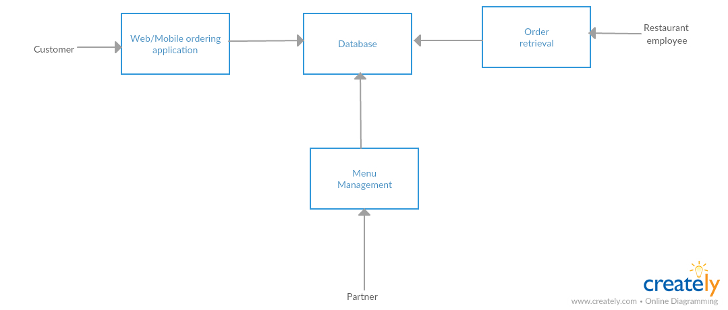
Program requirements cont`d

Slide 21
Program requirements cont`d
The system will be user friendly. The user friendly and interactive interface design will help achieve the ability for the customer to browse through the application and make direct selections of desired products so they can place orders without any struggle of some sort.
Functional requirements
Functional requirements define the capabilities and functions that a system must be able to perform successfully. As can be seen in the system model diagramed above, each of the three system components essentially provides a layer of isolation between the end user and the database. The motivation behind this isolation is twofold.
Firstly, allowing the end user to interact with the system through a rich interface provide a much more enjoyable user experience, particularly for the non-technical users which will account for the majority of the system’s users. In addition, this isolation layer also protects the integrity of the database by preventing users from taking any action outside those which the system is designed to handle
Because of this design pattern, it is essential to estimate exactly which functions a user will be presented and these functions are outlined below, grouped by component.

Slide 22
Program requirements cont`d
The Web/Mobile Ordering application
Users will be provided with the following functionality:
Create an account.
Manage their account.
Log in to the system.
Navigate the available restaurants.
Navigate a certain restaurant’s menu.
Select product(s) from the menu.
Customize options for selected product(s).
Add product(s) to their cart.
Review their cart.
Remove product(s) from their cart.
Provide delivery details if “Delivery” is selected.
Provide payment details if “Self-collection” selected
Place an order.
Receive confirmation in the form of an invoice through an email or SMS.

Slide 23
Program requirements cont`d
Menu Management System
The menu management system will be available only to the Admistrator, as the name suggests, allow them to manage the menu that is displayed to users of the web ordering system. The functions afforded by the menu management system provide user with the ability to, using a graphical interface:
Add a new/update/delete vendor to/from the restaurant`s menu.
Add a new/update/delete food category to/from the menu.
Add a new/update/delete food product to/from the menu.
Add a new/update/delete option for a given product.
Update price for a given product.
Update default options for a given product.
Update additional information (description, photo, etc.) for a given product.
It is anticipated that the functionality provided by this component will be one of the first things noted by the restaurant user, as they will have to go through it to configure their menu, etc. before beginning to actually take orders. Once everything is initially configured, however, this component will likely be the least used, as menu updates generally do not occur with great frequency.

Slide 24
Program requirements cont`d
Order Retrieval System
Of the three components, the order retrieval system is functionally the simplest. Like the menu management system, it is designed to be used only by restaurant employees, and provides the following functions:
Retrieve new orders from the database.
Display the orders in an easily readable, graphical way.
Mark an order as having been processed and remove it from the list of active orders.

Slide 25
Program requirements cont`d
A non-functional requirement is a requirement that specifies criteria that can be used to judge the operation of a system rather than specific behaviours. Some of the non-functional requirements include:
There should be sufficient network bandwidth.
Backup – provision for data backup.
Maintainability – easy to maintain.
Performance and response time – fast response.
Usability – easy to use.
Easily upgradable

Slide 26
Diagrams

Slide 27
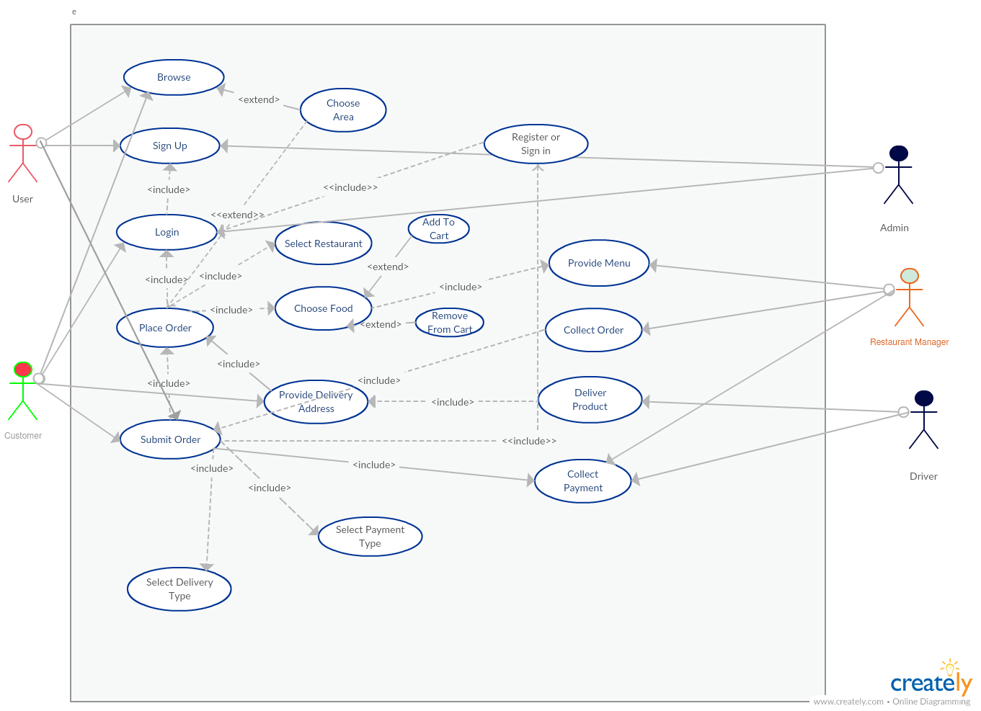
Use case model

Slide 28
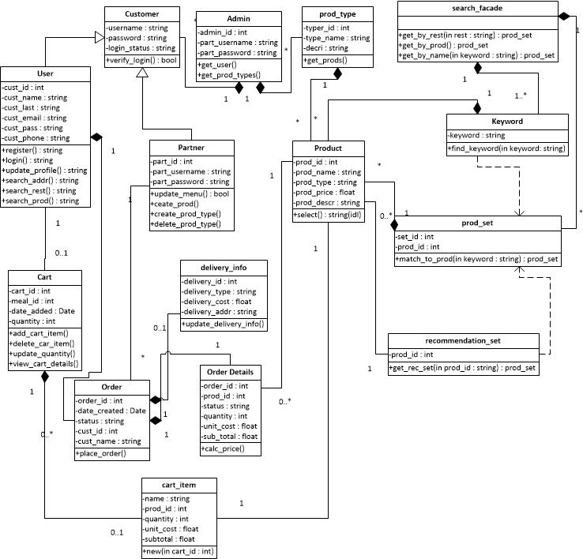
Class Diagram

Slide 29
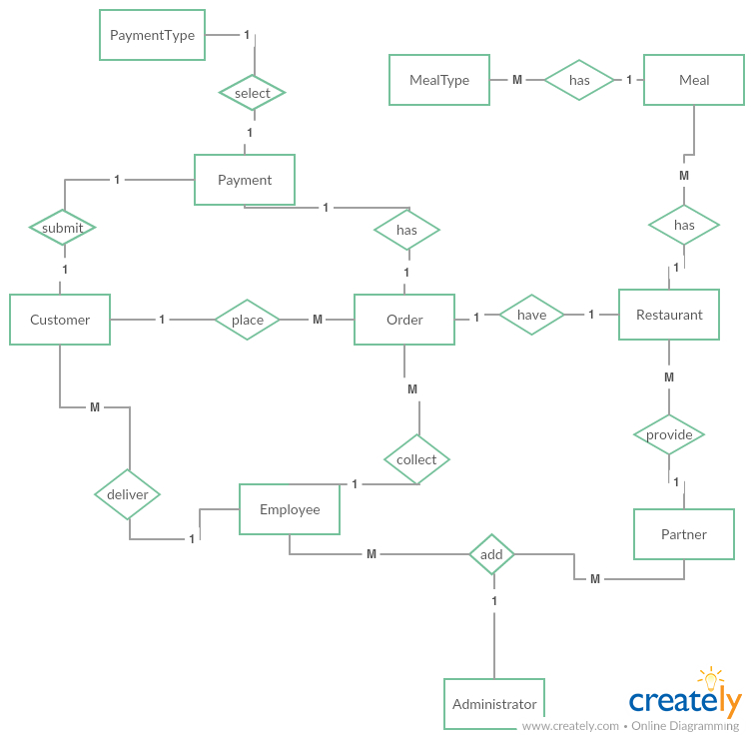
Entity Relationship Diagram

Slide 30
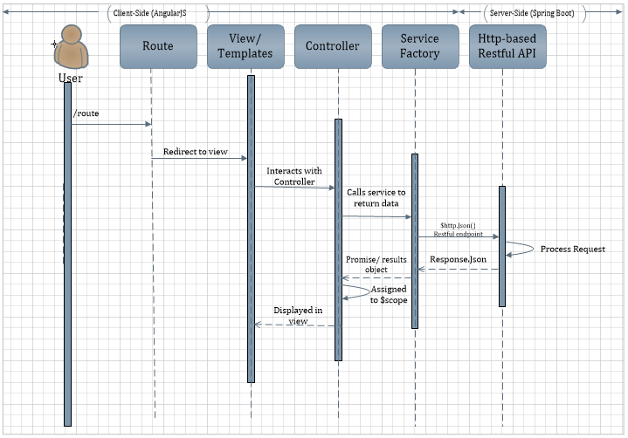
Sequence Diagram

Slide 31
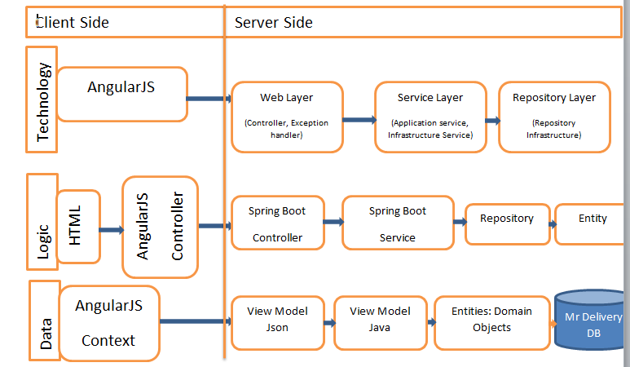
Architecture Diagram

Slide 32
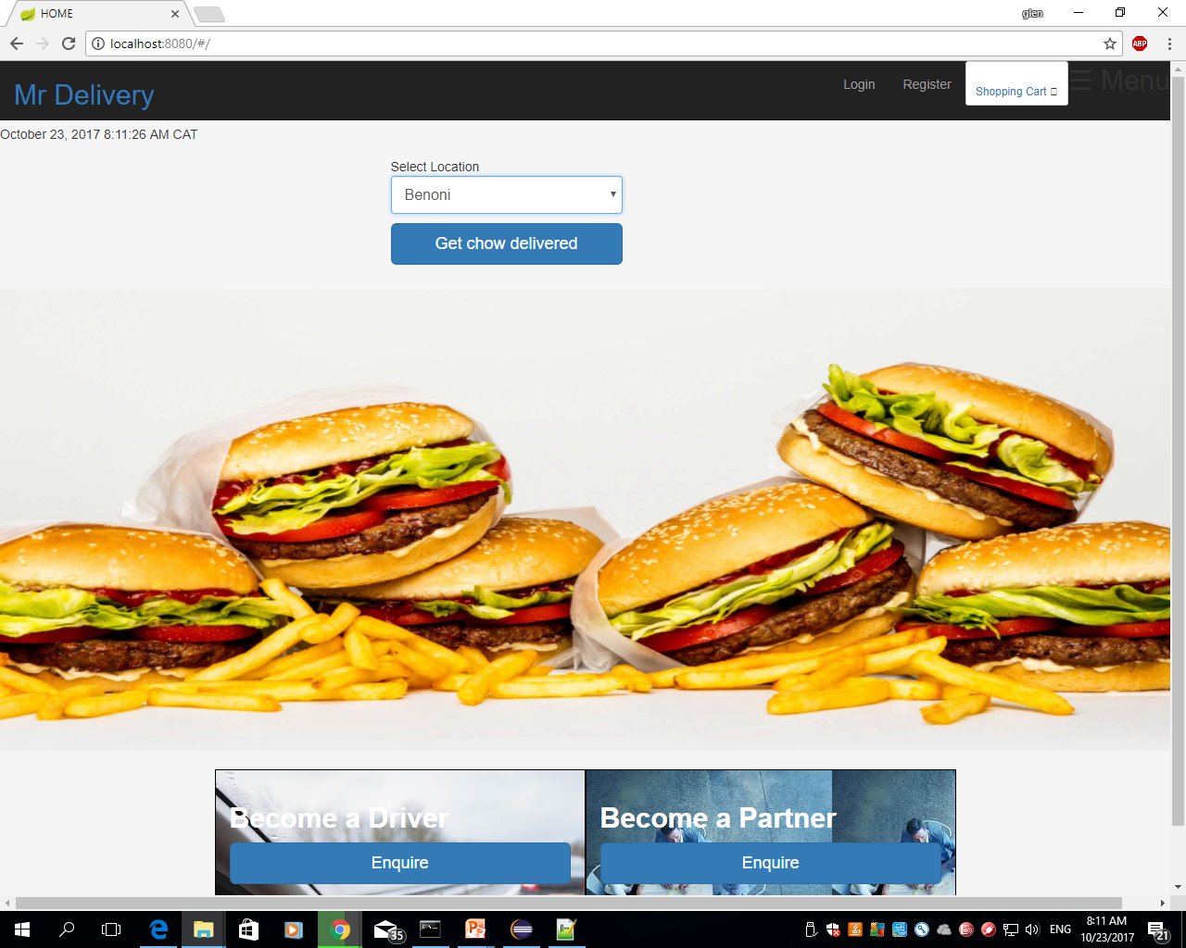
Project Presentation Home page

Slide 33
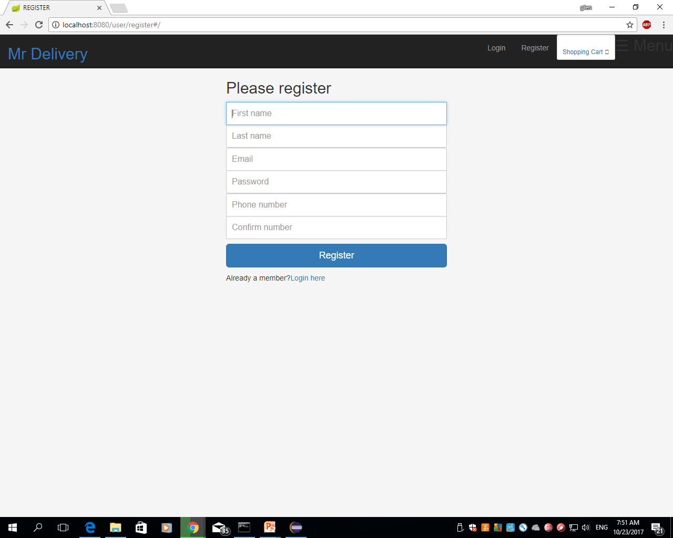
Registration Page

Slide 34
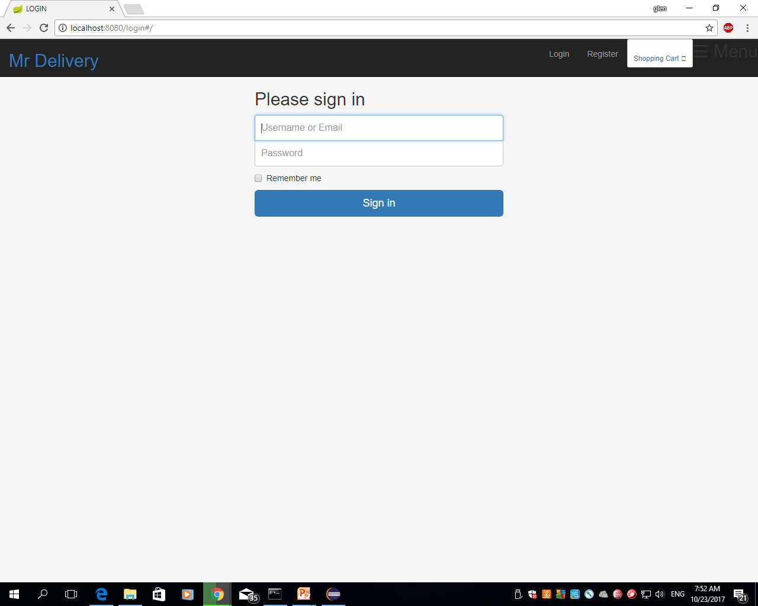
Login page

Slide 35
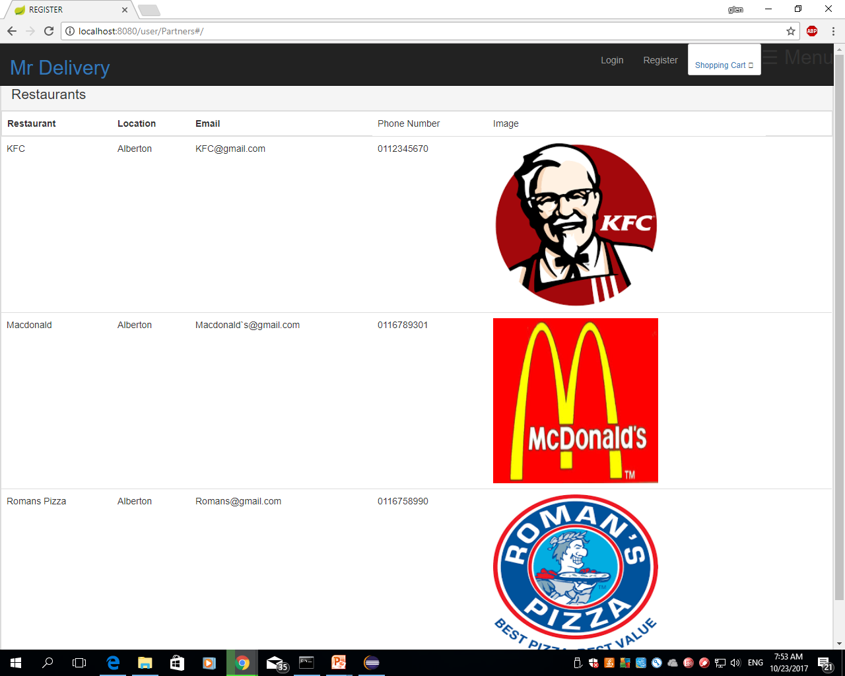
Restaurant Menu

Slide 36
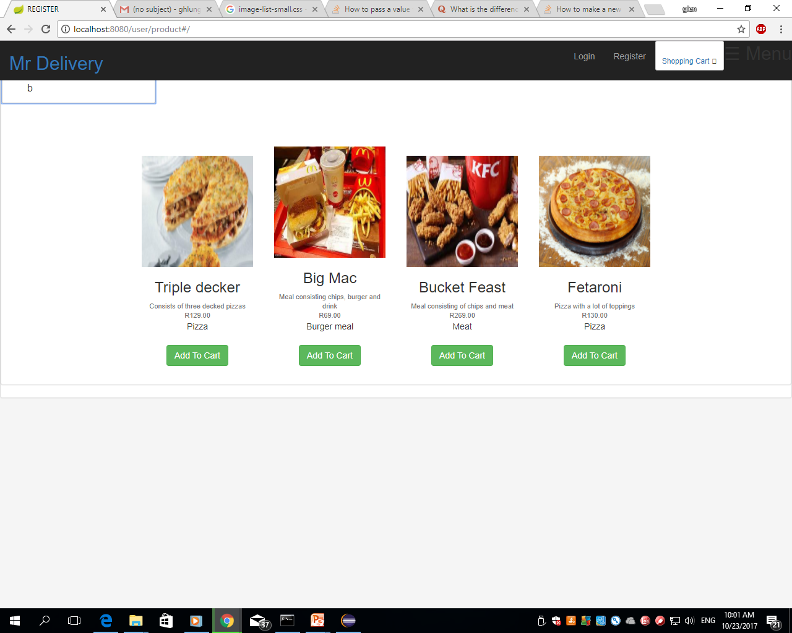
Products Menu

Slide 37
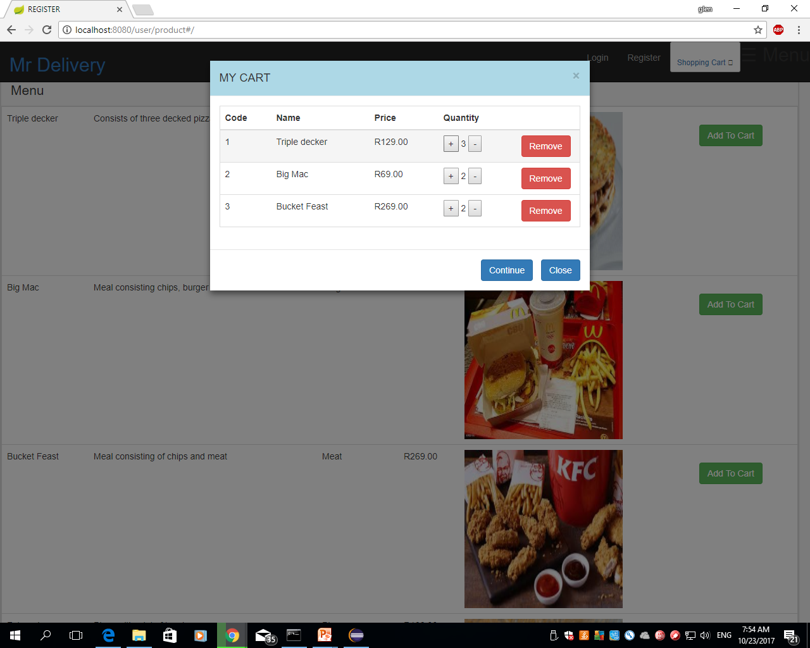
Shopping Cart

Slide 38
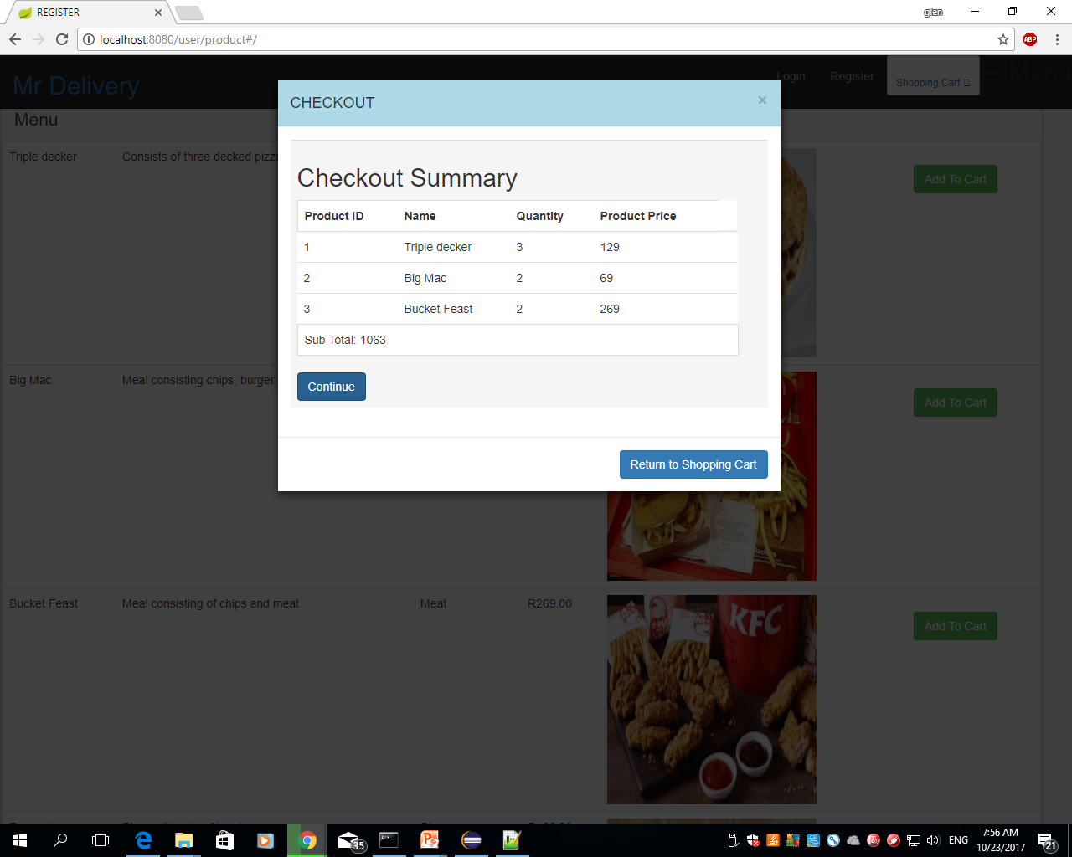
Checkout Summary

Slide 39
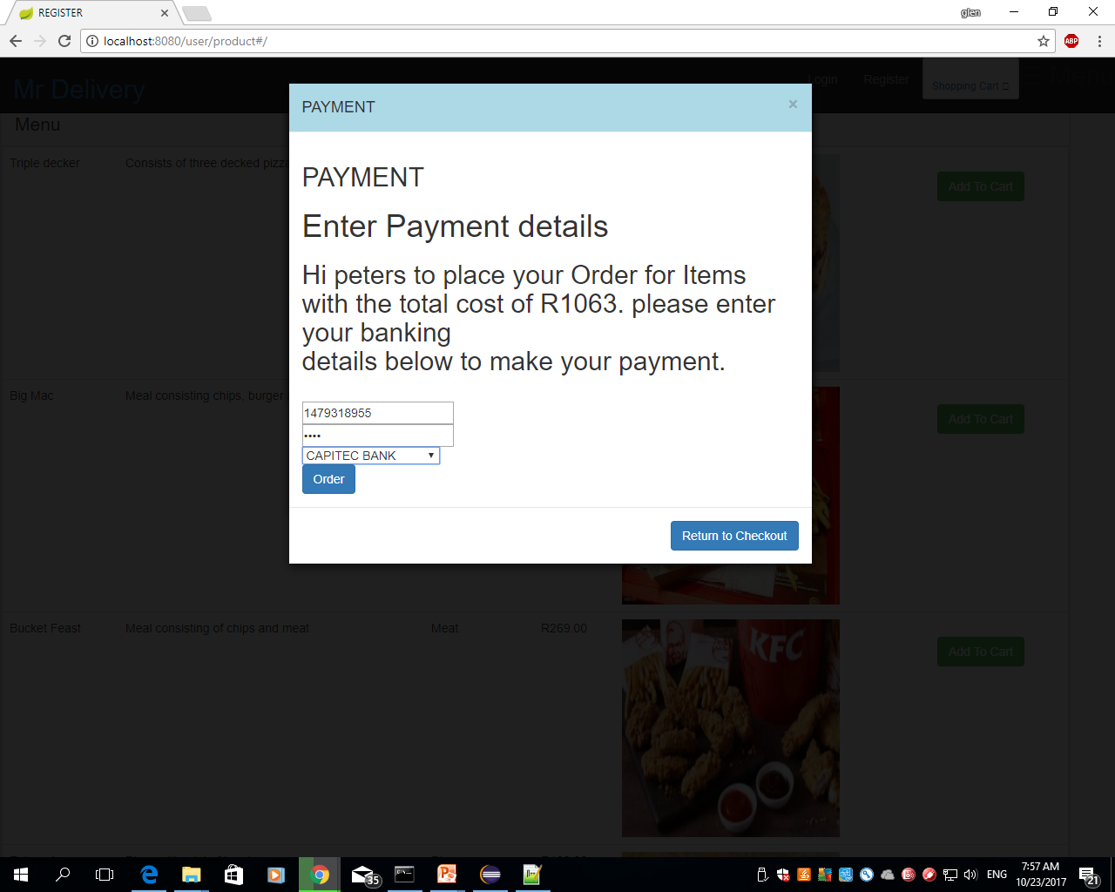
Payment

Slide 40
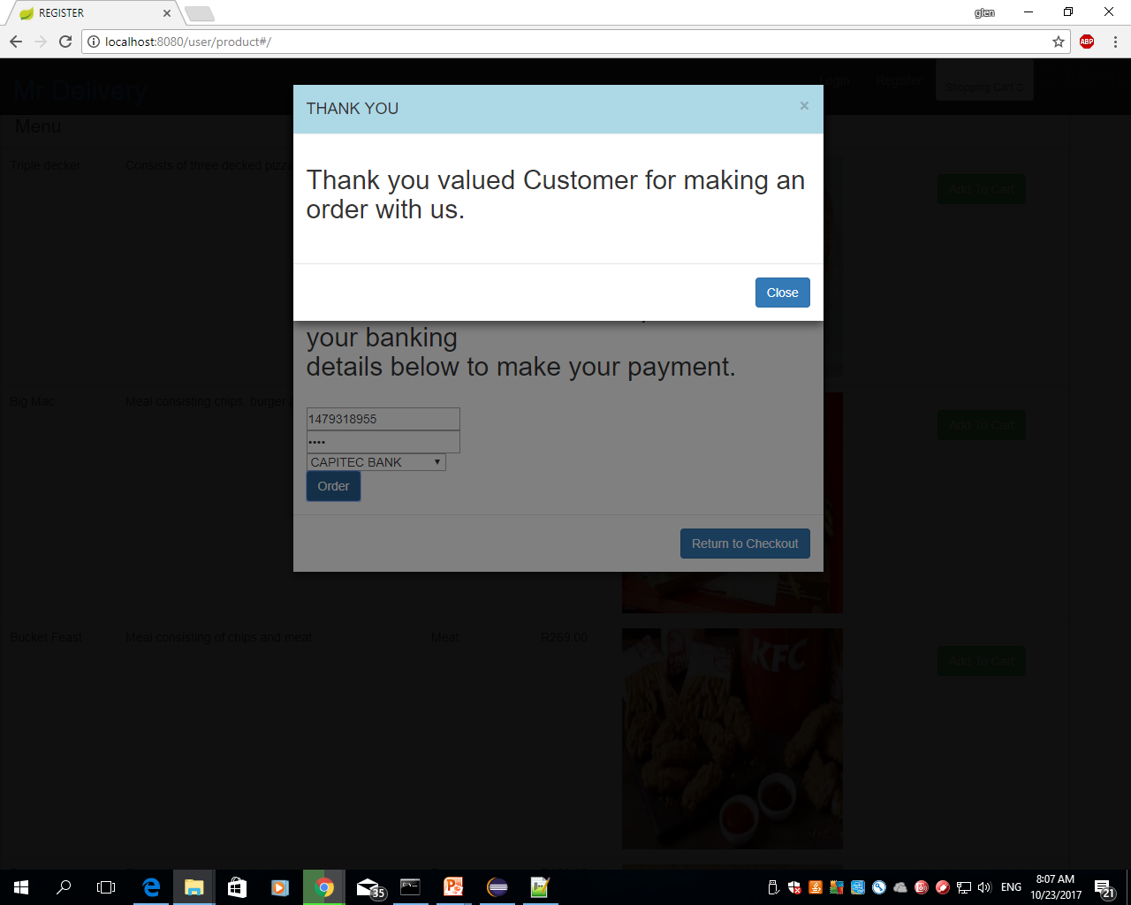
Thank Message

Slide 41
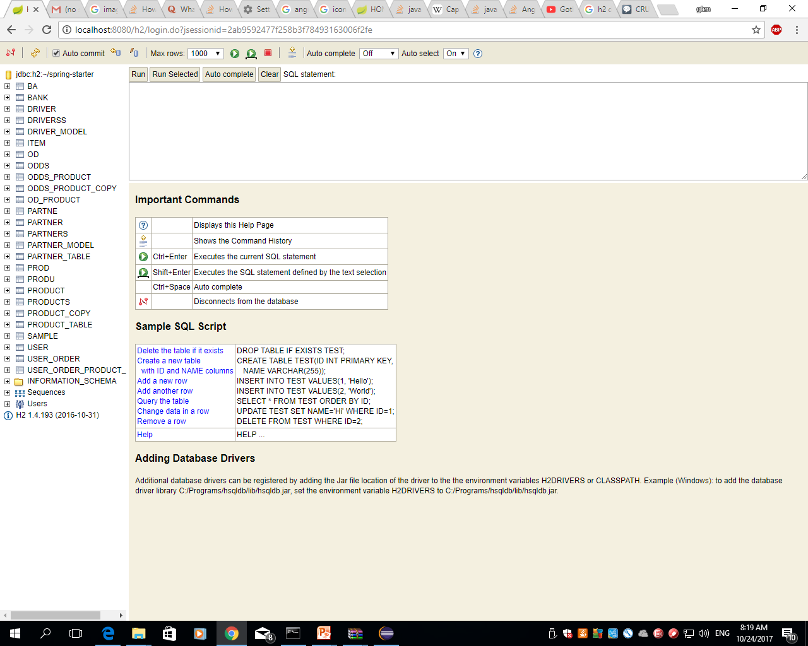
Database

Slide 42
JSON Web Token (JWT) is an open standard (RFC 7519) that defines a compact and self-contained way for securely transmitting information between parties as a JSON object. This information can be verified and trusted because it is digitally signed. JWTs can be signed using a secret (with the HMAC algorithm) or a public/private key pair using RSA.
Let's explain some concepts of this definition further.
Compact: Because of their smaller size, JWTs can be sent through a URL, POST parameter, or inside an HTTP header. Additionally, the smaller size means transmission is fast.
Self-contained: The payload contains all the required information about the user, avoiding the need to query the database more than once.

Slide 43
Authentication: This is the most common scenario for using JWT. Once the user is logged in, each subsequent request will include the JWT, allowing the user to access routes, services, and resources that are permitted with that token. Single Sign On is a feature that widely uses JWT nowadays, because of its small overhead and its ability to be easily used across different domains.
Information Exchange: JSON Web Tokens are a good way of securely transmitting information between parties. Because JWTs can be signed—for example, using public/private key pairs—you can be sure the senders are who they say they are. Additionally, as the signature is calculated using the header and the payload, you can also verify that the content hasn't been tampered with.

Slide 44
Hibernate ORM (Hibernate in short) is an object-relational mapping tool for the Java programming language. It provides a framework for mapping an object-oriented domain model to a relational database. Hibernate handles object-relational impedance mismatch problems by replacing direct, persistent database accesses with high-level object handling functions.

Slide 45
JPA describes the management of relational data in applications using Java. JPA(Java Persistence API) is an interface for persistence providers to implement. Hibernate is one such implementation of JPA. When you use Hibernate with JPAyou are actually using the Hibernate JPA implementation.

